Slide 1
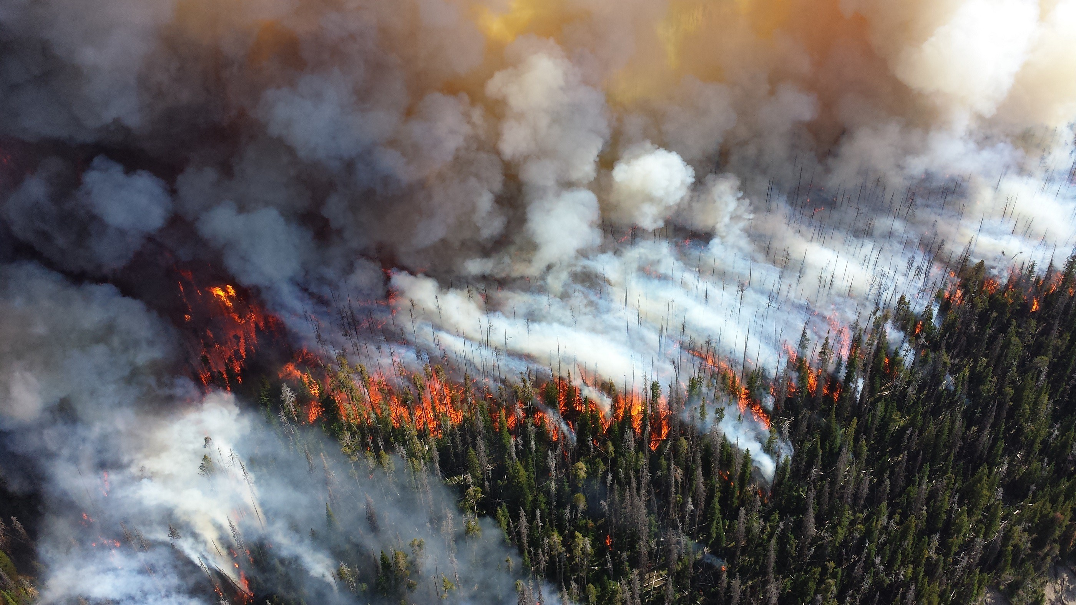
Wildfire size classification
9/September/2020
Presenter: Marcelo R García E.

Slide 2
Methodology Outline
EDA
  Visualizing data
    Boxplots
    Histogram – Bar plot
  Data Cleaning
    Getting rid of outliers
    Spotting missing values
    One Hot Encode categorical data
    Standardize data
Filling missing data
Feature engineering
Dimensionality reduction
  PCA
  Feature importance
Model Building
  Model selection
  Hyper-Parameters fine-tuning
  Model Evaluation
  Model training

Slide 3
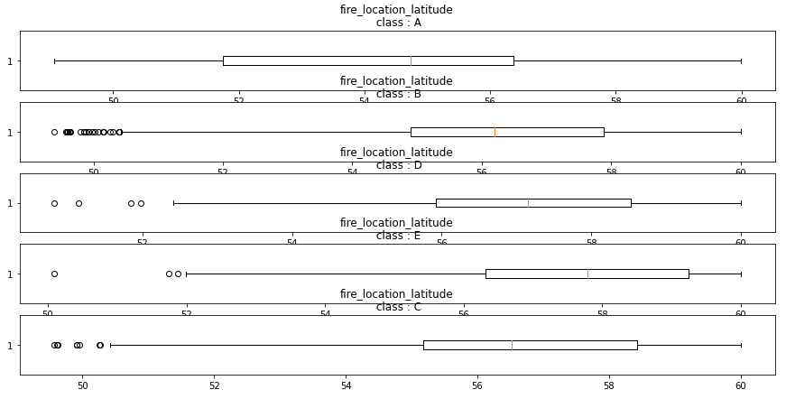
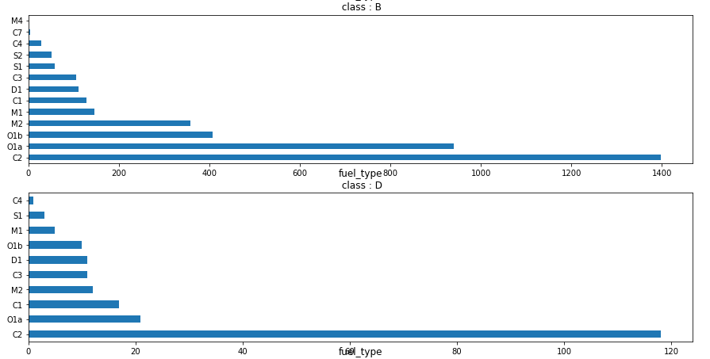
Exploratory Data Analysis (EDA) - visualization

Slide 4
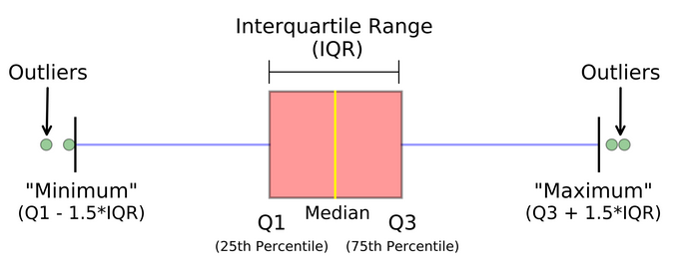
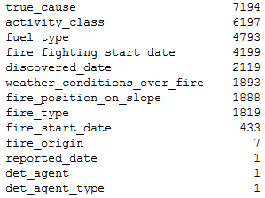
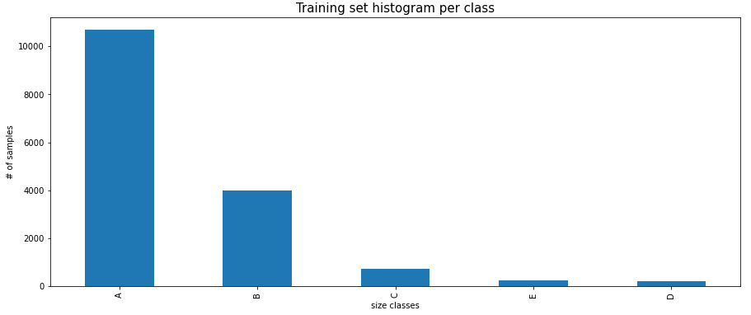
EDA – data cleaning
Getting rid of outliers
Spotting missing values
One Hot Encode categorical data
Standardize data
  Used the RobustScaler instead of the StandardScaler
Parse dates from strings to datetime data types
Spotting Model imbalance

Slide 5
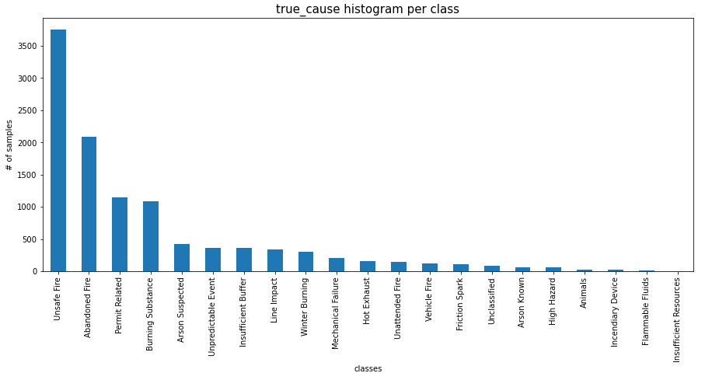
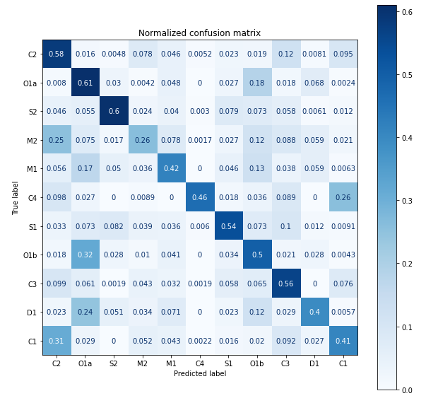
Filling missing data
Tried different approaches:
  Categorical features
    Fill with most frequent value ❌
    Fill with a model trained based on other features ✔️
      Model used was a Balanced Random Forest
  Datetime features
    Fill missing values with closest datetime features ✔️
      Closest features found in the EDA. e.g:

Slide 6
Feature engineering
Datetime
  Subtract some datetime features to get duration time in minutes. e.g:
    fire_duration = ex_fs_date - fire_start_date
    fire_fight_response_time = fire_fighting_start_date -discovered_date
fire_number: CWF031
  Location
  Number of wildfires

Slide 7
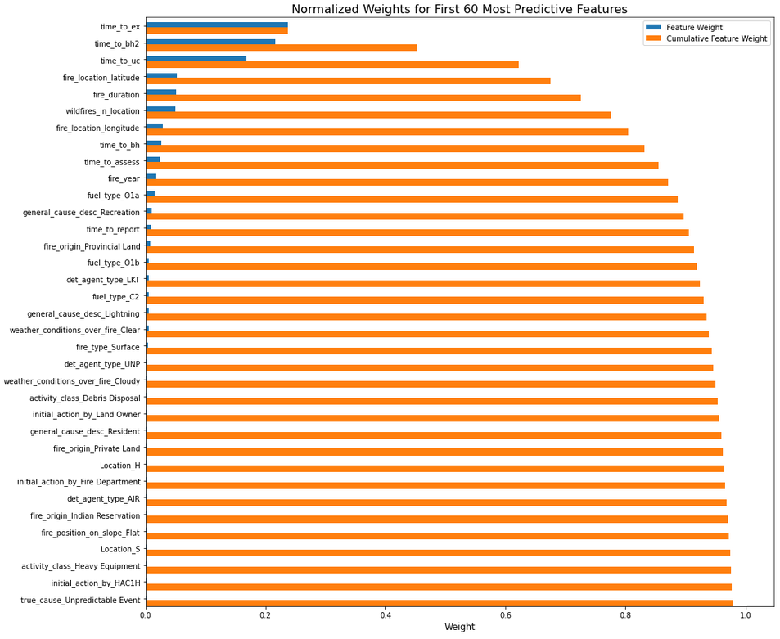
Dimensionality reduction
PCA
Feature importance
  Gradient boosting to get feature importance

Slide 8
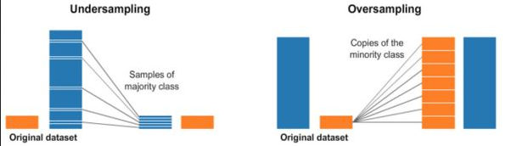
Model Building
Model selection
  F score on the 5-fold cross-validation score
  prediction/training time
  Considered models:
    Random Forest
    Balanced Random forest
      A balanced random forest randomly under-sampling each boostrap sample to balance it.
    Adaboost
    Gradient boosting
    Hist Gradient Boosting
    Neural Network
    SVM

Slide 9
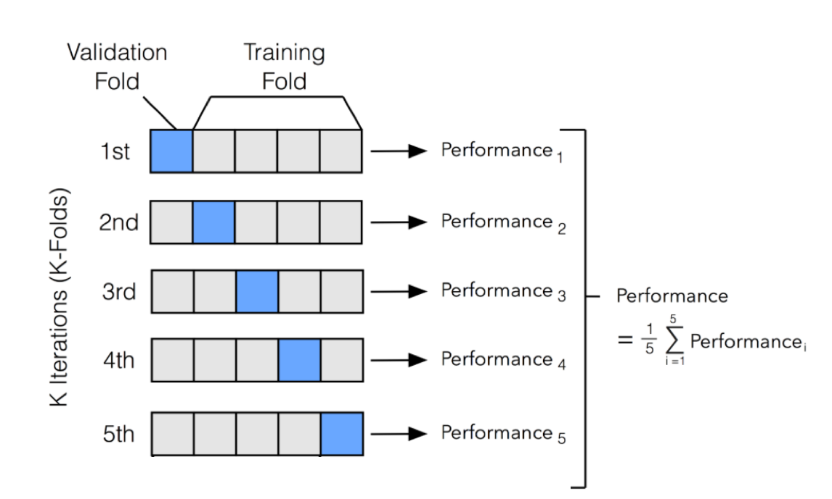
Model Building
Model Evaluation
  F1 macro score 5-fold cross validation was used with 3 repetitions

Slide 10
Model Building
Hyper-Parameters fine-tuning
  Random Search
  Grid search
  Most important Hyper-parameters (from most valuable to less valuable):
    class_weights (penalizes each class with certain weight):
      Balanced – penalizes each class based on the number of samples presented in the dataset. i.e. classes that have less samples get a higher weight.
      Custom weights - penalizes each class based on custom weights.
    max_leaf_nodes
    max_depth
    Criterion = ‘Entropy’
    ccp_alpha – post pruning the tree
Train model with the whole training dataset

Slide 11
Thank you!

